Slide 1
Share your product
Presented By
MD. TAKI TAHMID (17-34481-2)
RAFID SHARIAR RIMU (18-36685-1)
RAHUL HASSAN (18-39145-3)
SOLAEM ABDULLAH FAHIM (18-39146-3)

Slide 2
Idea generation
Our project is “Share Your Product”. Sometime people require different types of product for a limited time which is very expensive or rare. For example, Camera, Boat, Sporting Equipment, Power tools, Camping Equipment and many more could be the rental product. If people can rent those items from someone by spending a little amount of money, it will be more efficient. It also may help people to earn extra income by giving on rent their product and equipment. So that owner, customer and the management all of them will be benefitted.
We are going to build a software that will help us to reduce the complexity and lessen our problem. Our solution is capable of solving this kind of problem efficiently according to the demands of the people. Moreover, there is no appropriate solution to lessen those problems. Our solution is very much innovative, interesting and distinct because of time saving and cost-efficient features for the user.

Slide 3
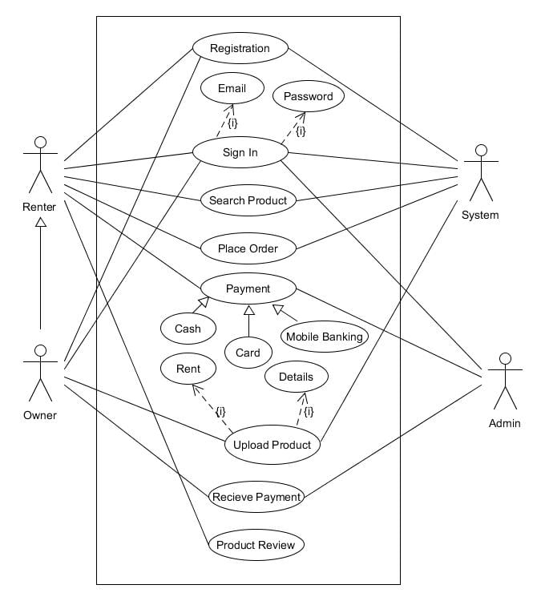
Use Case

Slide 4
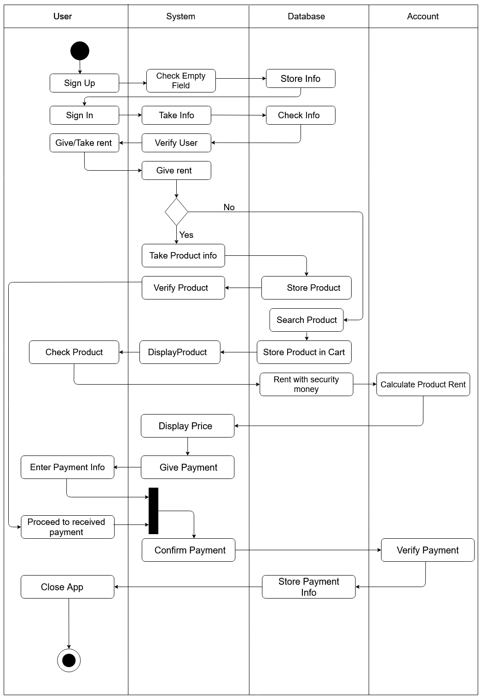
Activity Diagram

Slide 5
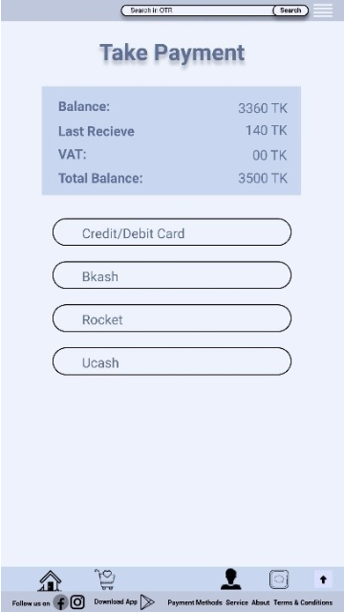
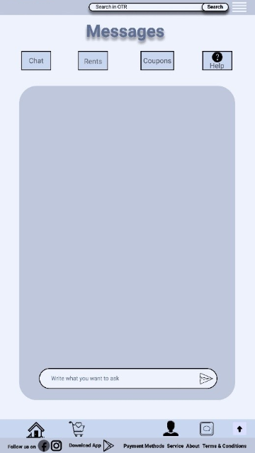
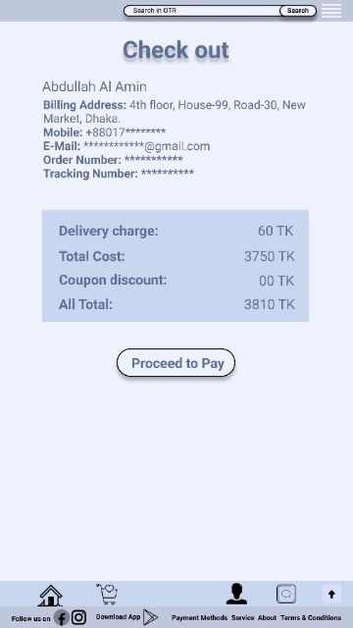
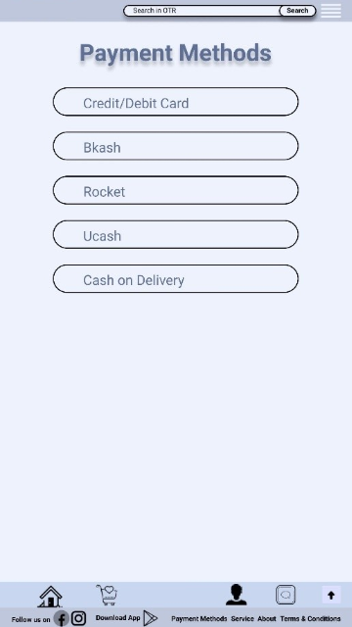
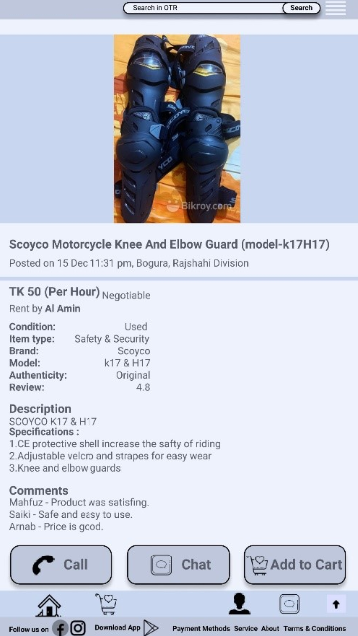
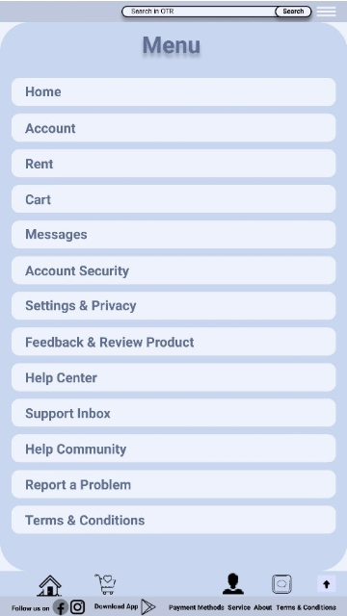
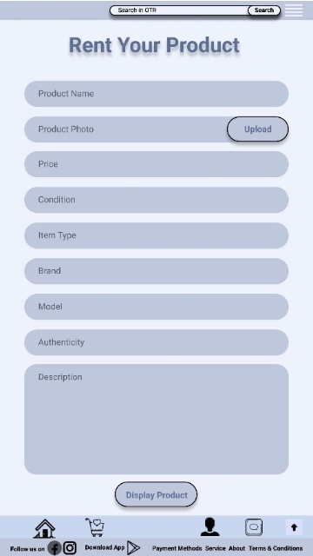
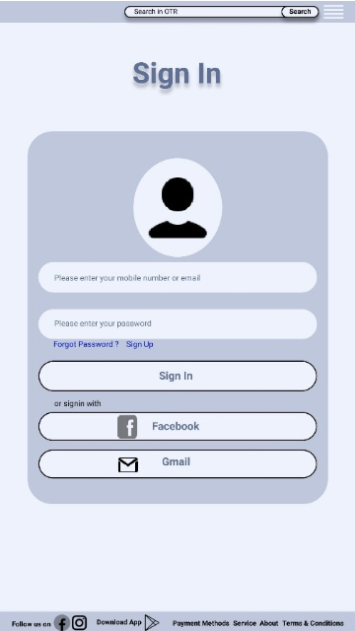
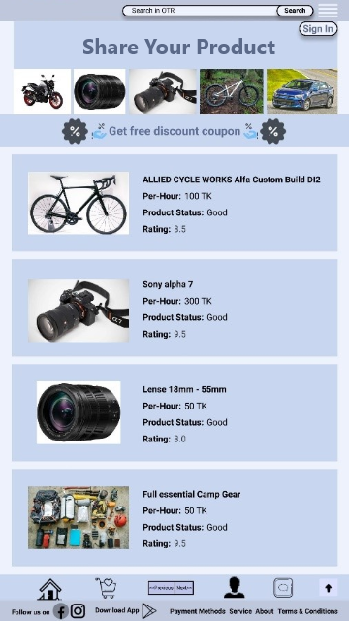
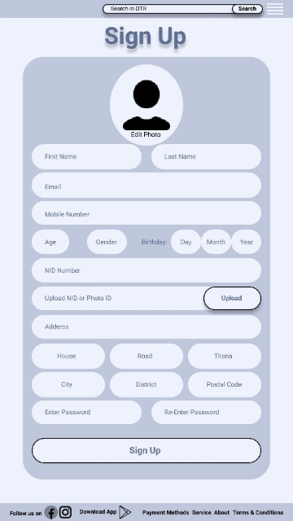
use interface design

Slide 6
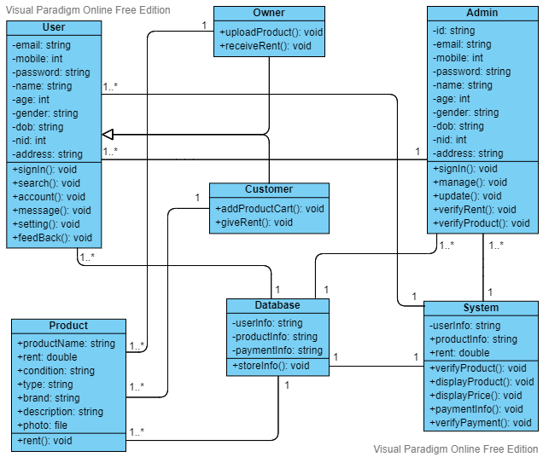
class

Slide 7
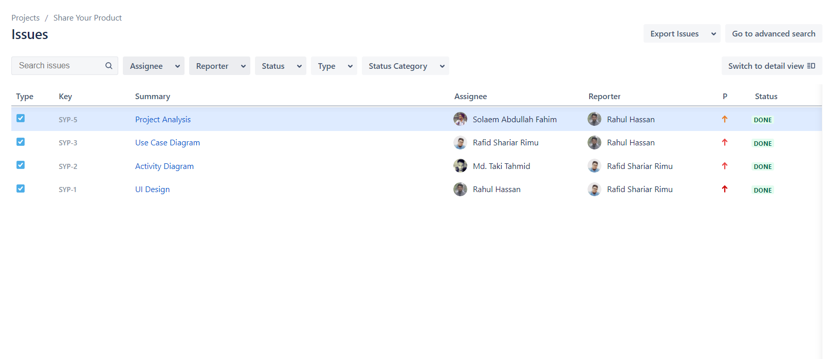
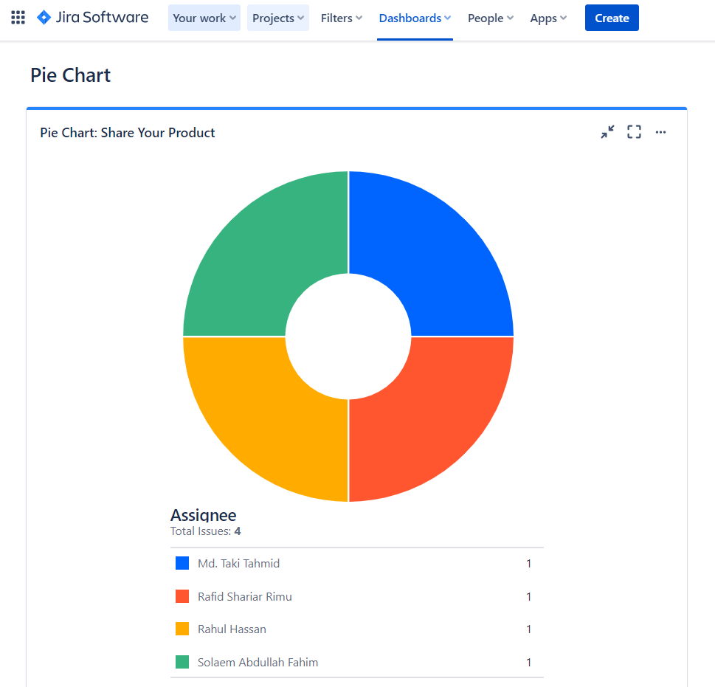
Jira

Slide 8
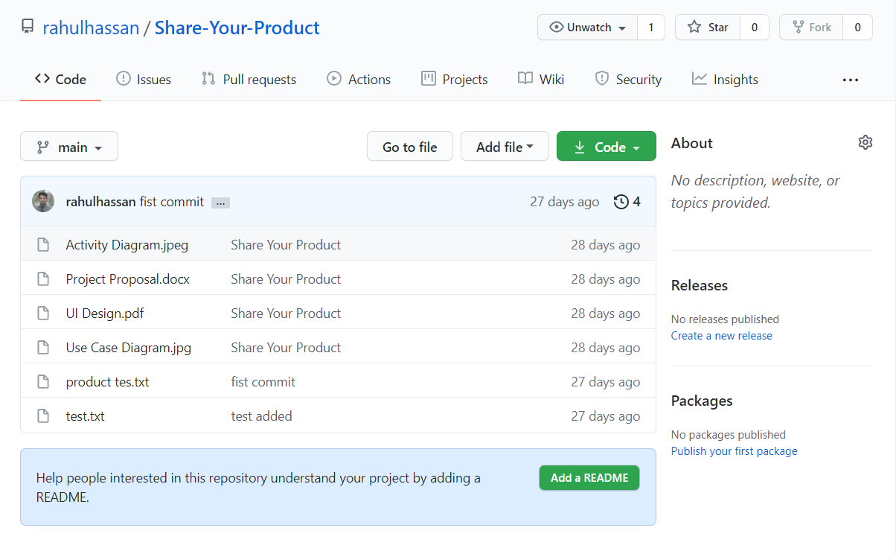
GIT
Reference: https://github.com/rahulhassan/Share-Your-Product.git

Slide 9
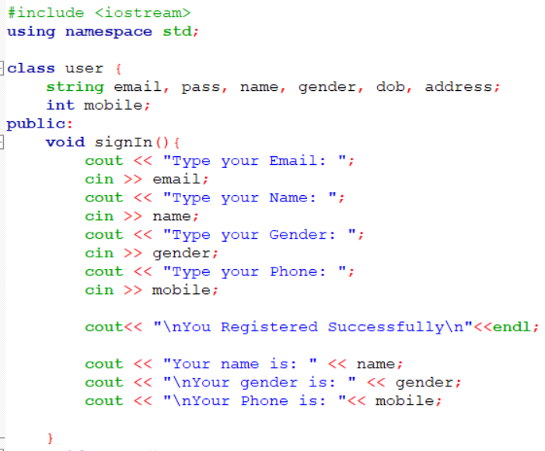
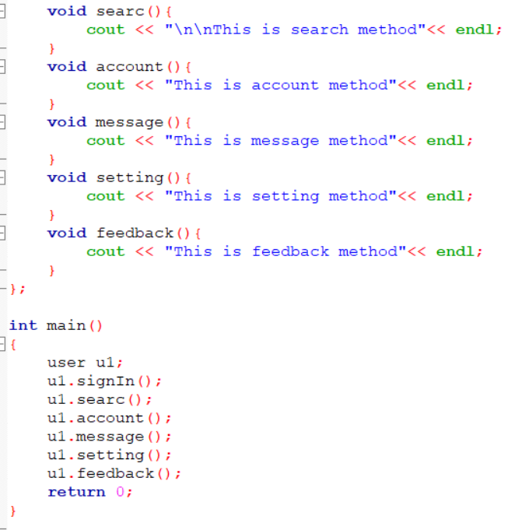
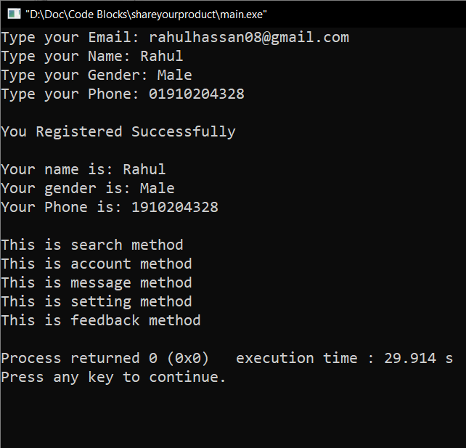
Code

Slide 10
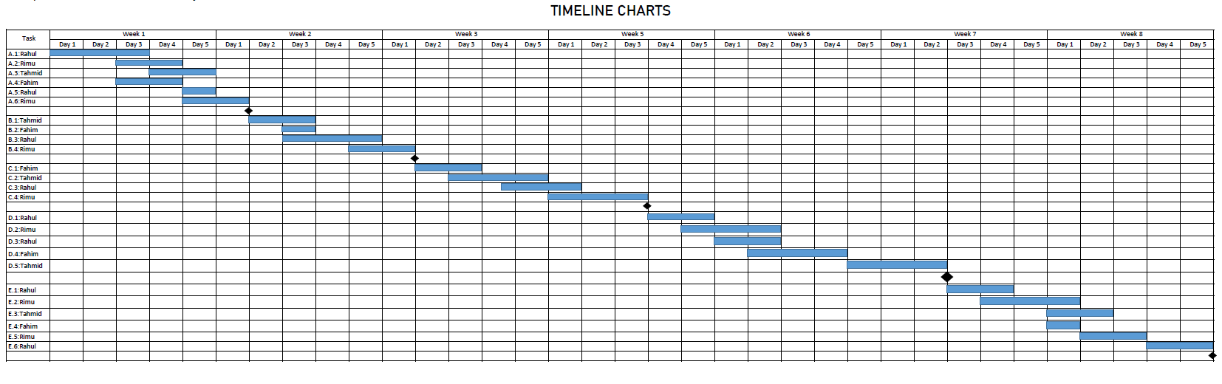
Project Scheduling

Slide 11
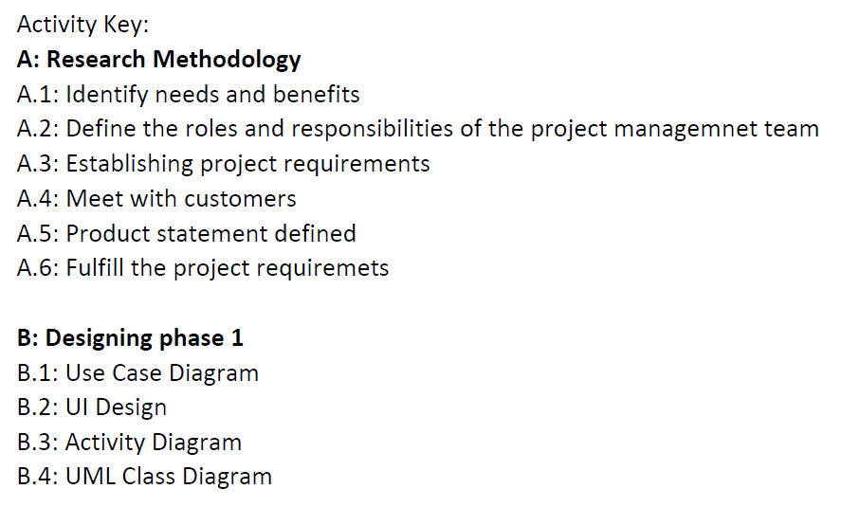
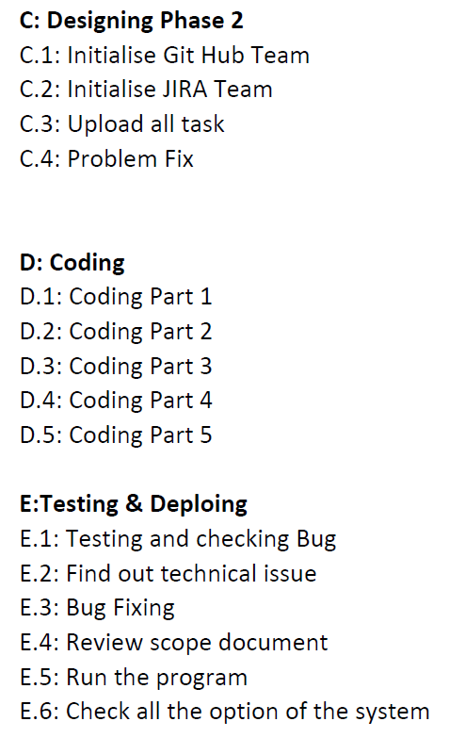
Project Scheduling

Slide 12
effort estimation
Coefficient = 2.4 Project complexity=1.05 SLOC dependent coefficient= 0.38 Source lines of code, SLOC = 8000 Effort = PM= Coefficient <Effort Factor>*(SLOC/1000)^P =2.4*(8000/1000)^{1.05} =21 Development time = DM = 2.50* (PM)^{T} =2.50* (21)^{0.38} =7.95 Required Number of People= ST= PM/DM = 21/7.95 =2.64 =3

Slide 13
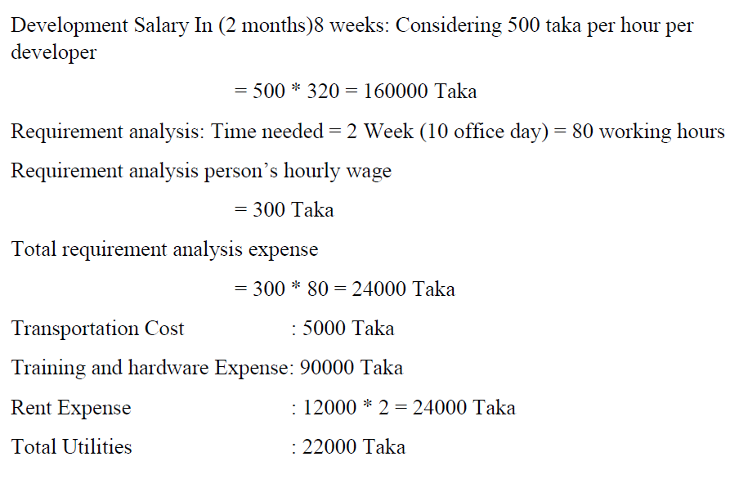
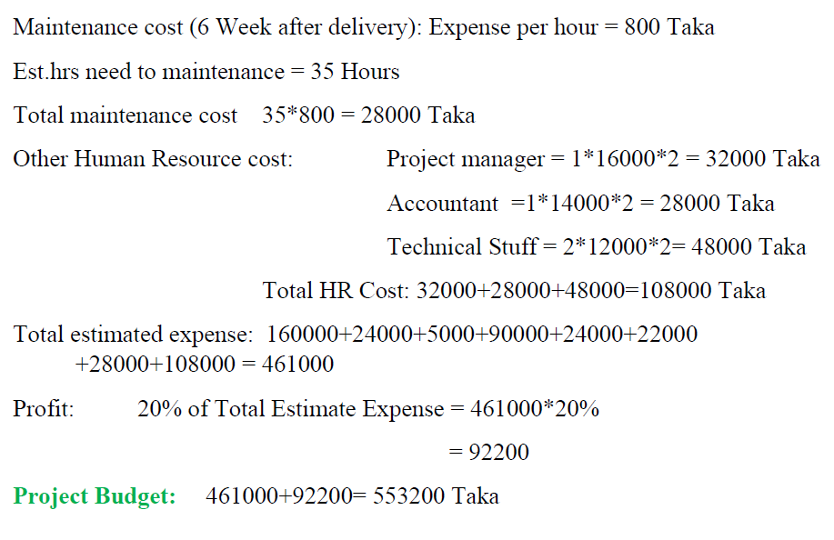
budgeting

Slide 14
THANK YOU

